Slide 1
HOME AUTOMATION
YOUR HOME ON YOUR HAND

Slide 2
INTRO TO HOME AUTOMATION
‘Home automation’ is system designed to control and supervise the home appliances via the Internet.
A Relevant idea in today’s scenario
Keeping the technological aspect in mind we also want to change how we make our home smarter
An idea that lets us control our home with a simple push of a button

Slide 3
Architectural Model
Interpreting Home Automation with an Architectural Model
Easy to understand to the Neutral Observers
Gives an extra dimension to the project

Slide 4
Key Features
Voice Control
Interactive Button Control
Video Streaming
Temperature Monitoring System
Face Recognition Based Entry
Room Light Color Control via Android
Automated loadshedding Sync Control system
Basic LDR based Automatic Lights
Laser Based Security System

Slide 5

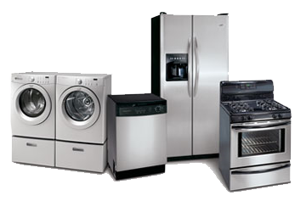



Voice Control
Controls the different home appliances via voice commands
Based On Google’s Speech to text API

Slide 6

Button Controls
Control different Appliances using Buttons.

Slide 7


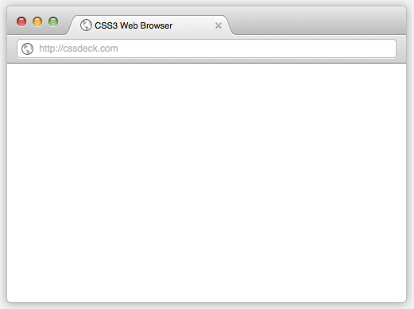

Video Steaming
Able to view live video of our home via The Internet through Android Application or a Web Page.

Slide 8
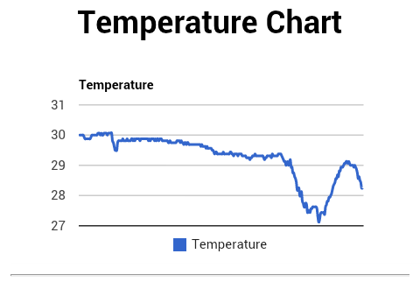
Temperature Monitoring System
Logs the Temperature of the specified room into a database periodically.
Displays the Logged data in a Graph.

Slide 9

Face Recognition Based Entry
Used for opening doors

Slide 10
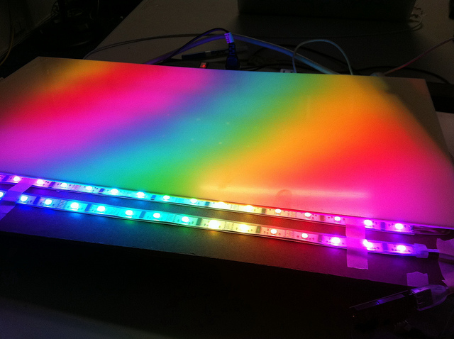
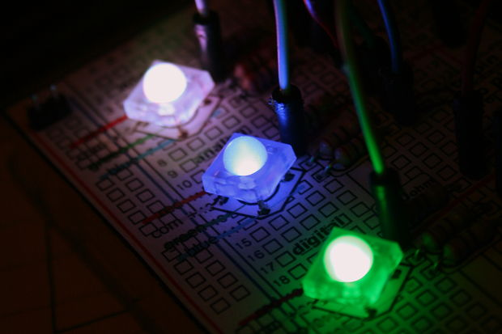
Color Lights
Able to control the color of light in the specified room using Android Application.
Uses RGB LEDs to produce the different colors

Slide 11
Automated loadshedding Sync Control system
Turns off specific devices few minutes before loadshedding and turns them back on after loadshedding
Totally Automated Process

Slide 12
Basic LDR based Automatic Lights
Turns light during the night and turns then off in the morning automatically

Slide 13
Laser Based Security System
Laser triggers an Alarm
Alerts the user via SMS

